Slide 1
Real State System -Java and Data Structures
D2Real

Slide 2
This system is for …
To keep track of a company’s residential listings
Add house details using system
To view details of houses
To perform searching and sorting
& remove house records from system
Improvements …
increase productivity
reduce time spent on administration
replace all manual task

Slide 3
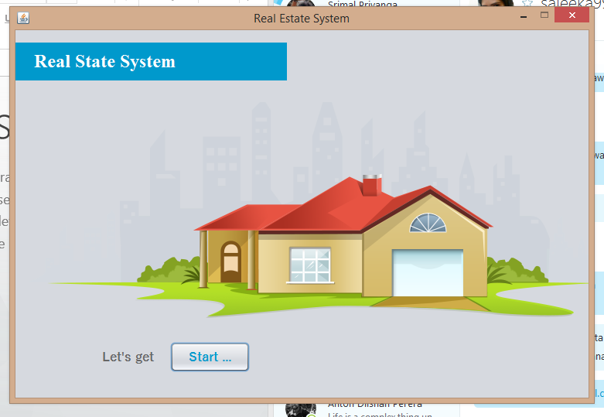
Architecture …
~/. based on MVC architecture
~/. user Friendly designing
~/. focus on high User Experience
~/. +Clean & Simple look & feel
Download :
https://github.com/UCDGeeks

Slide 4
How it Happened ..?
Java as main programming language
1 Main class to handle whole functionality on program
2 Modals to handle all data
3 Main java controller classes
4 Views for user interactions
Have used Git as a VCS

Slide 5
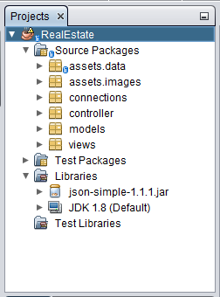
Have a look..

Slide 6
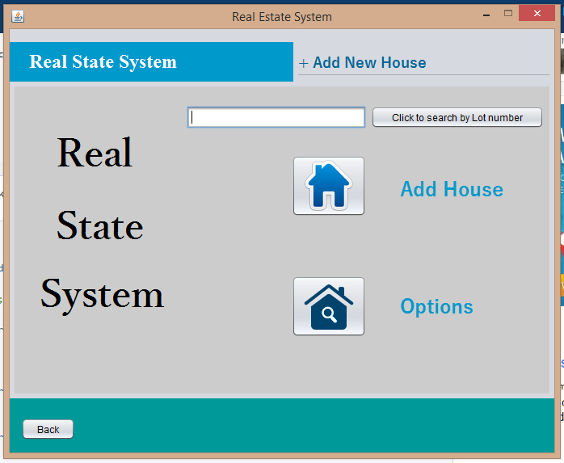
When it works..

Slide 7
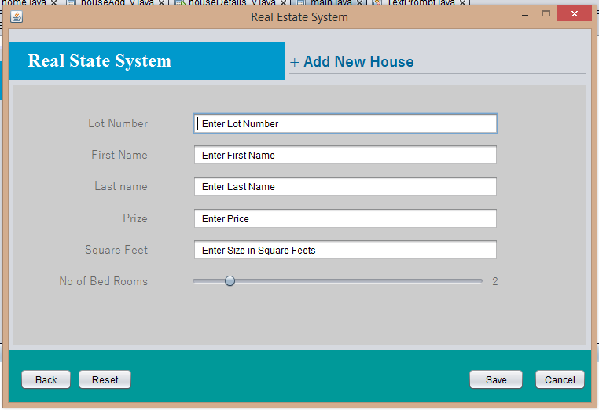
Add a house…

Slide 8
Search house by Lot Number…

Slide 9
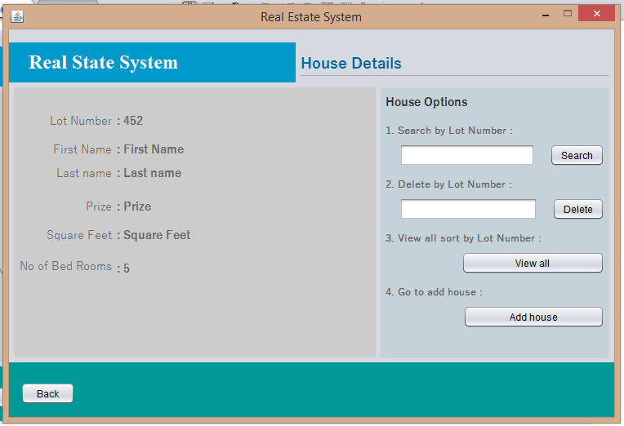
View house details…

Slide 10
Delete house by Lot Number…

Slide 11
Options …
~/. Search by Lot Number
~/. Delete by Lot Number
~/. Go to add house
~/. + View all Sort by Lot Number

Slide 12
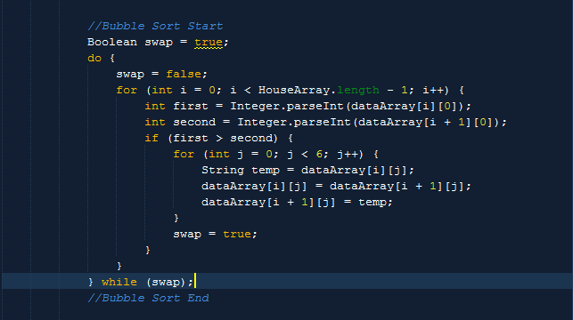
Where DSA...?

Slide 13
How we use DSA...?
Bubble Sort as a sorting algorithm
it’s fast
& really good when use for small arrays
Arrays & list to store data
Linear search as searching algorithm
- Perfect for unsorted arrays
- Because system use small arrays

Slide 14
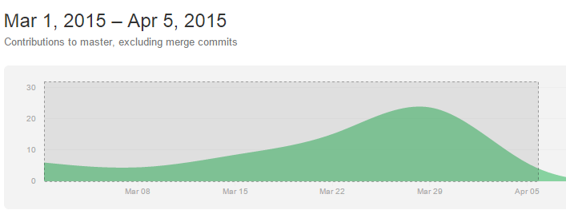
Team Work & Timeline
~/. Srimal 14208910
~/. Anton 14209006
~/. Thisaru 14209028
~/. Sajeeka 14209028
~/. Kalana 14208883
Host :
https://github.com/UCDGeeks/RealEstate_System

Slide 15
Thank You !
D2Real

